Slide 1
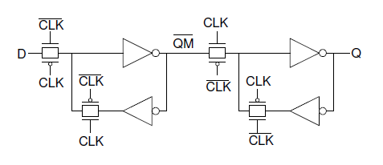
Methodology 2
Designed a Flip-Flop using logic gates from Methodology 1
Composed FF with transmission gates and inverters
Varied size ratio between pmos and nmos transistors in order to decrease rise and fall times to below 100ps
Determined the setup time of FF by continuously decreasing the time frame between input transition (D) and clock transition until output (Q) becomes distorted
Pin pointed the hold time of FF by changing the input (D) soon after clock begins to rise and viewing output to see if desired waveform is produced
In order to meet 100ps rise/fall times, setup and hold times must meet 25ps and 120ps time frames respectively
Flip Flop

